Slide 1
Open Sourcing From Within Your Company, For Your Company
Future IT Camp, Tuesday, June 12th, 2012
by Bob Williams
Notes:
Thank you for having me
I’m really glad and honored to be here
Profound impact from an IT camp I went to
Hope you have one too
We’re going to make this a conversation

Slide 2
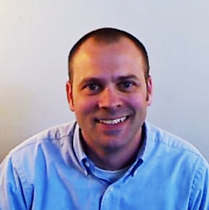
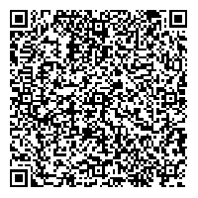
About Me
Bob Williams
CTO / Analytics Evangelist
bob.williams@sparcedge.com
Twitter
@_bobwilliams
Come see Innovation, Culture
and Open Source in Action
tours@sparcedge.com - tours held daily.
www.sparcedge.com
Notes:
I am responsible for leadership, technology vision and direction
As well as Open Source
I am very active on Twitter. You can find me @_bobwilliams
BigData, Analytics, DataScience, OpenSource, PaaS
Come in for a Tour
Set stage for successful projects, teams working together, solving problems together
And I am very passionate about things like
open communication,
innovation through collaboration and
free exchange of ideas
Which is great because

Slide 3
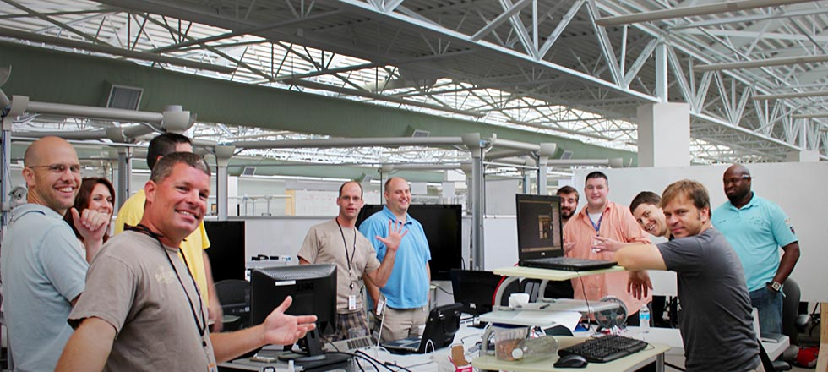
Who is SPARC!
Software Product Development
2011 Best Place to Work in SC
165+ employees / 500% Growth in 2011
Notes:
The company I work for fully embraces my passions
At SPARC we believe we engage people through better information
We have a really good work environment and we’ll be talking about that more
Very honored to have been voted the best place to work in SC for both small and medium size companies
Decent size shop and we’ve grown a lot and are still seeing fantastic growth
And oh yea…we write software ☺
Whether it be for Enterprise, Cloud, Web, Mobile, Cyber, Analytics, Culture, Engagement, Green Energy

Slide 4
Open Source Your Entire Organization
Open Source Everything!
Notes:
And I want you to walk away from this experience thinking of how and what it means to Open Source everything
Not just use open source software or contribute to it
I challenge businesses to open source entire departments, processes, the things they considered company secrets
Open source their entire organization…change their mindset
Open source can be and is about more than just software…it’s a philosophy…take it on as a way of life
It’s been around for since before software actually
Define open source
Talk about vested interest and sense of ownership and sense of contribution
Engaged, excited and innovate workforce
You’ll better understand your business and processes
Your competitors will become your collaborators
And It’s all basically for free
Not sure how to even start
5 easy steps

Slide 5
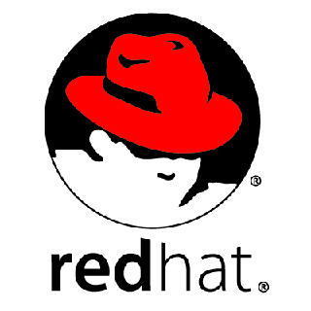



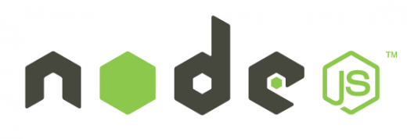





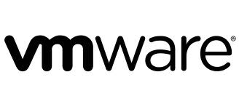


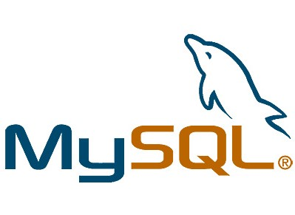
Step One – Use
Find open source software that you can use in your projects.
Get used to it and the open source model.
Take that first step to using it!
Notes:
So, step one is to use open source
Allow it, get used it, learn about it
Find projects you have today that can leverage open source software
Maybe that’s a lower risk project to use as your comfort builds
Maybe that’s an internal or R&D effort
But bring open source software inside your walls so you can understand the model and take that first step.
Start to build energy and momentum
We use open source

Slide 6
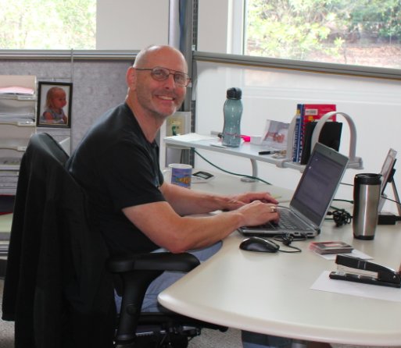
Step Two – Contribute
Give back to the community and uphold your end of the open source agreement.
Learn the “share/make it better” part of open source.
Take that next step!
Notes:
contribute back to the projects you are using
often overlooked piece
Community
Learn the benefits by seeing them work for someone else
Share/make it better
Dev download open source and not contribute
Share that energy with someone else
Take that next step!

Slide 7
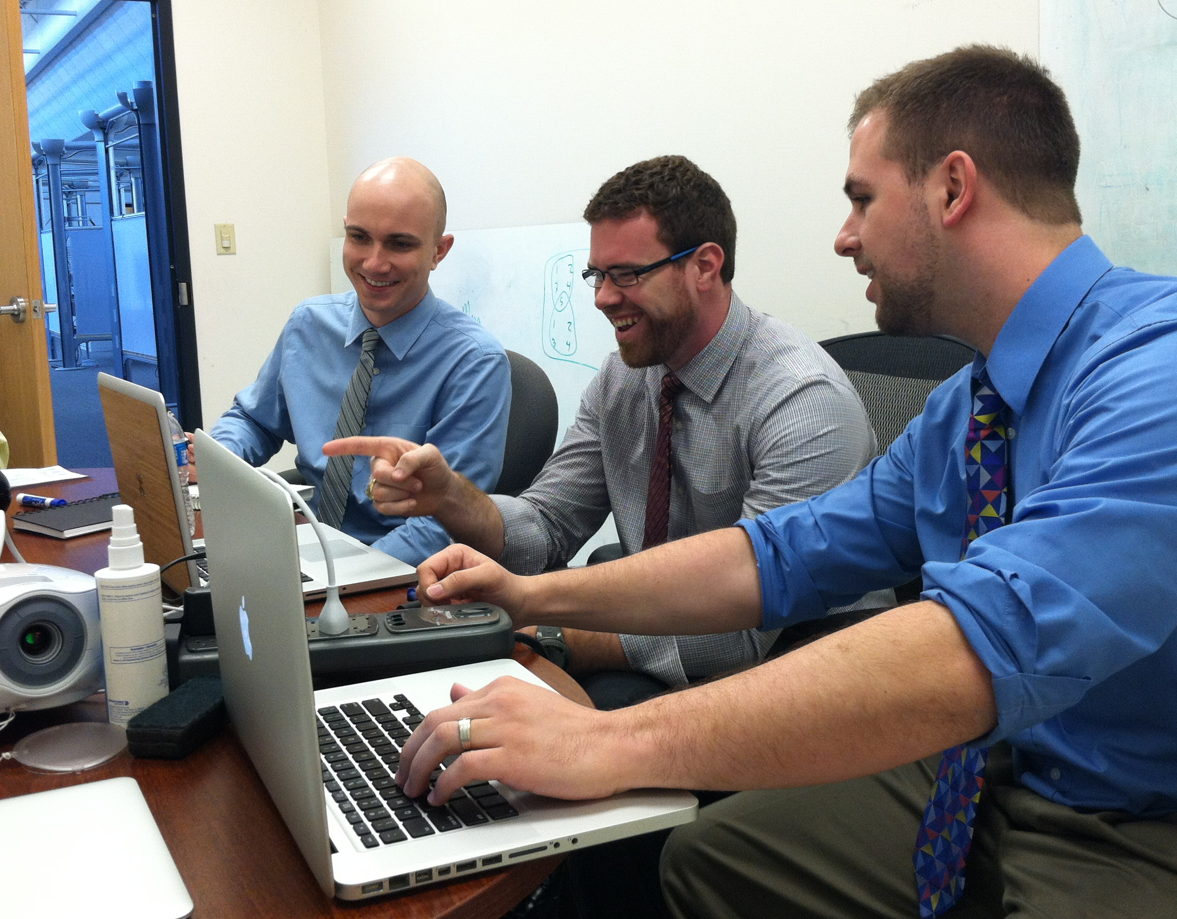
Step Three – In-House
Learn how to open source your own project(s).
Allow them to work together across teams and build better collaboration.
Create excitement and additional energy!
Notes:
in-house open source solution.
Open source your own project from the ground up
Use github, bitbucket or similar
Create the support for your engineers to contribute to each others projects
Set boundaries
Engineers are already doing this today; bring it in-house

Slide 8
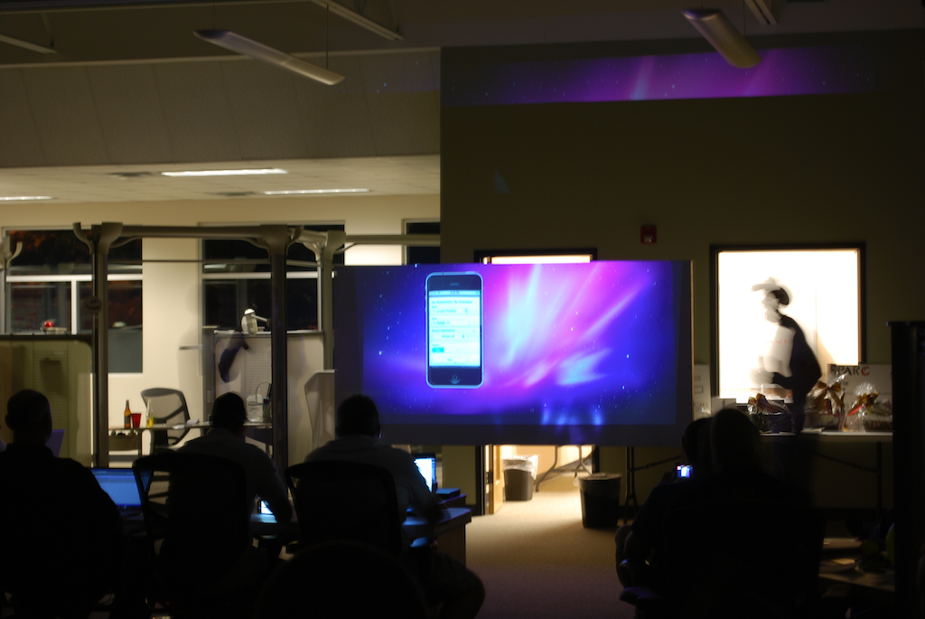
Step Four – Review
Developers like clout and like to be heard.
Let them show-off to their peers, managers and the company as a whole.
Create the platform for cultural acceptance of Open Source!
Notes:
I’m speaking to the IT leaders, managers, executives
Build the platform for cultural acceptance
Peers, leadership, executives, company
clout and bragging rights
Waterfall vs agile

Slide 9
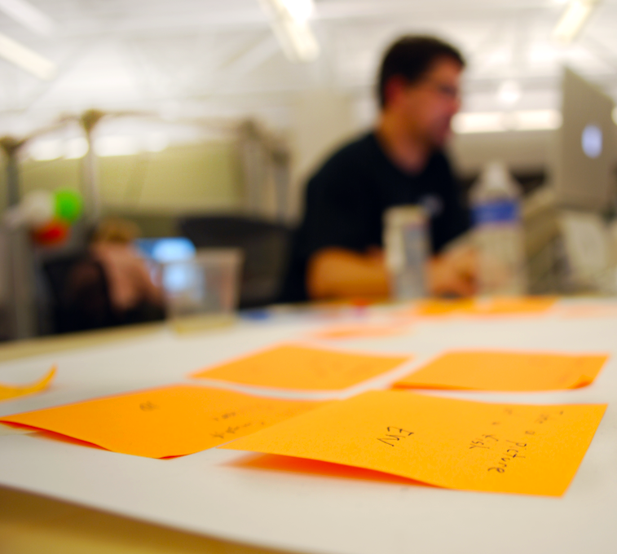
Step Five – Expand
Now that you have embraced open source, don’t stop.
In what other areas of your company could you apply the open source model?
Find ways to capitalize on the advantages of the open source model throughout your entire organization!
Notes:
Might seem the hardest but it’s the easiest step
You now understand open source
Have learned a lot
Don’t stop now
Take it to that next level
Corporate Website

Slide 10
Why?
So Why Does
SPARC
Open Source?
Notes:
Make it personal and tell you why SPARC open sources
At SPARC we do not believe in holding something of value tightly and closely to our chest.
With the growth we’ve seen and agility we move with
it requires too much effort and energy to take that tightly held value and retain its value or make it more valuable
In fact, we believe the full value can only be achieved by sharing and letting others help us make it more valuable
We do not open source everything…yet
But we are open sourcing more and more every day
And we are only seeing positive results and success from it
We have no reason not to open source
Where would Academia and Sciences and Medicine if people didn’t share and contribute to make things better?
How about Music, Sports, learn a new technique or riff or skill and then modify it for your needs and share
You can Google just about anything today.
Knowledge Worker and why it matters to open source

Slide 11
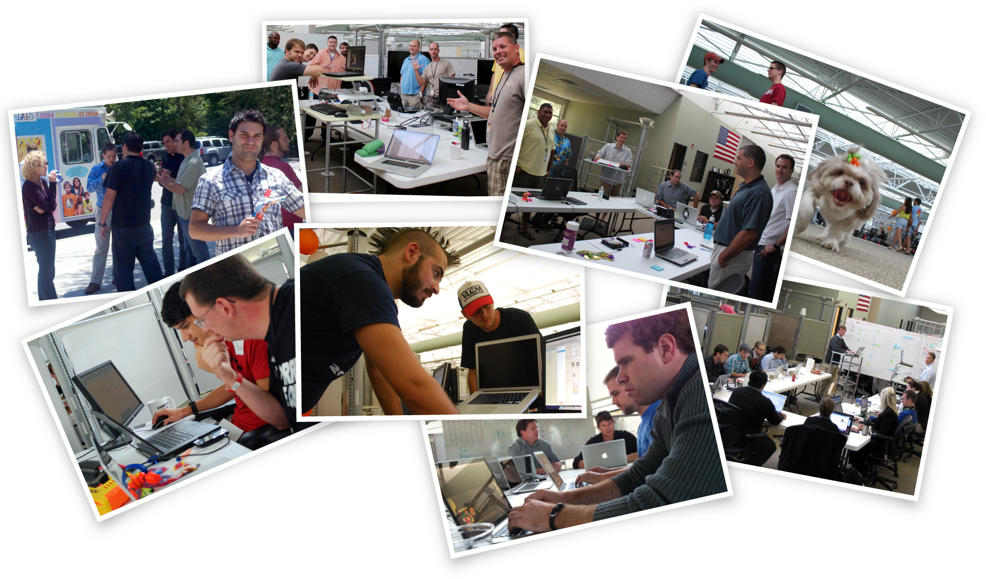
SPARC and Open Source
Notes:
Break?
You may be saying to yourself, I get the steps and why you do it, but I’m not sure of what I can actually do
Open source website?
Let me give you some examples

Slide 12
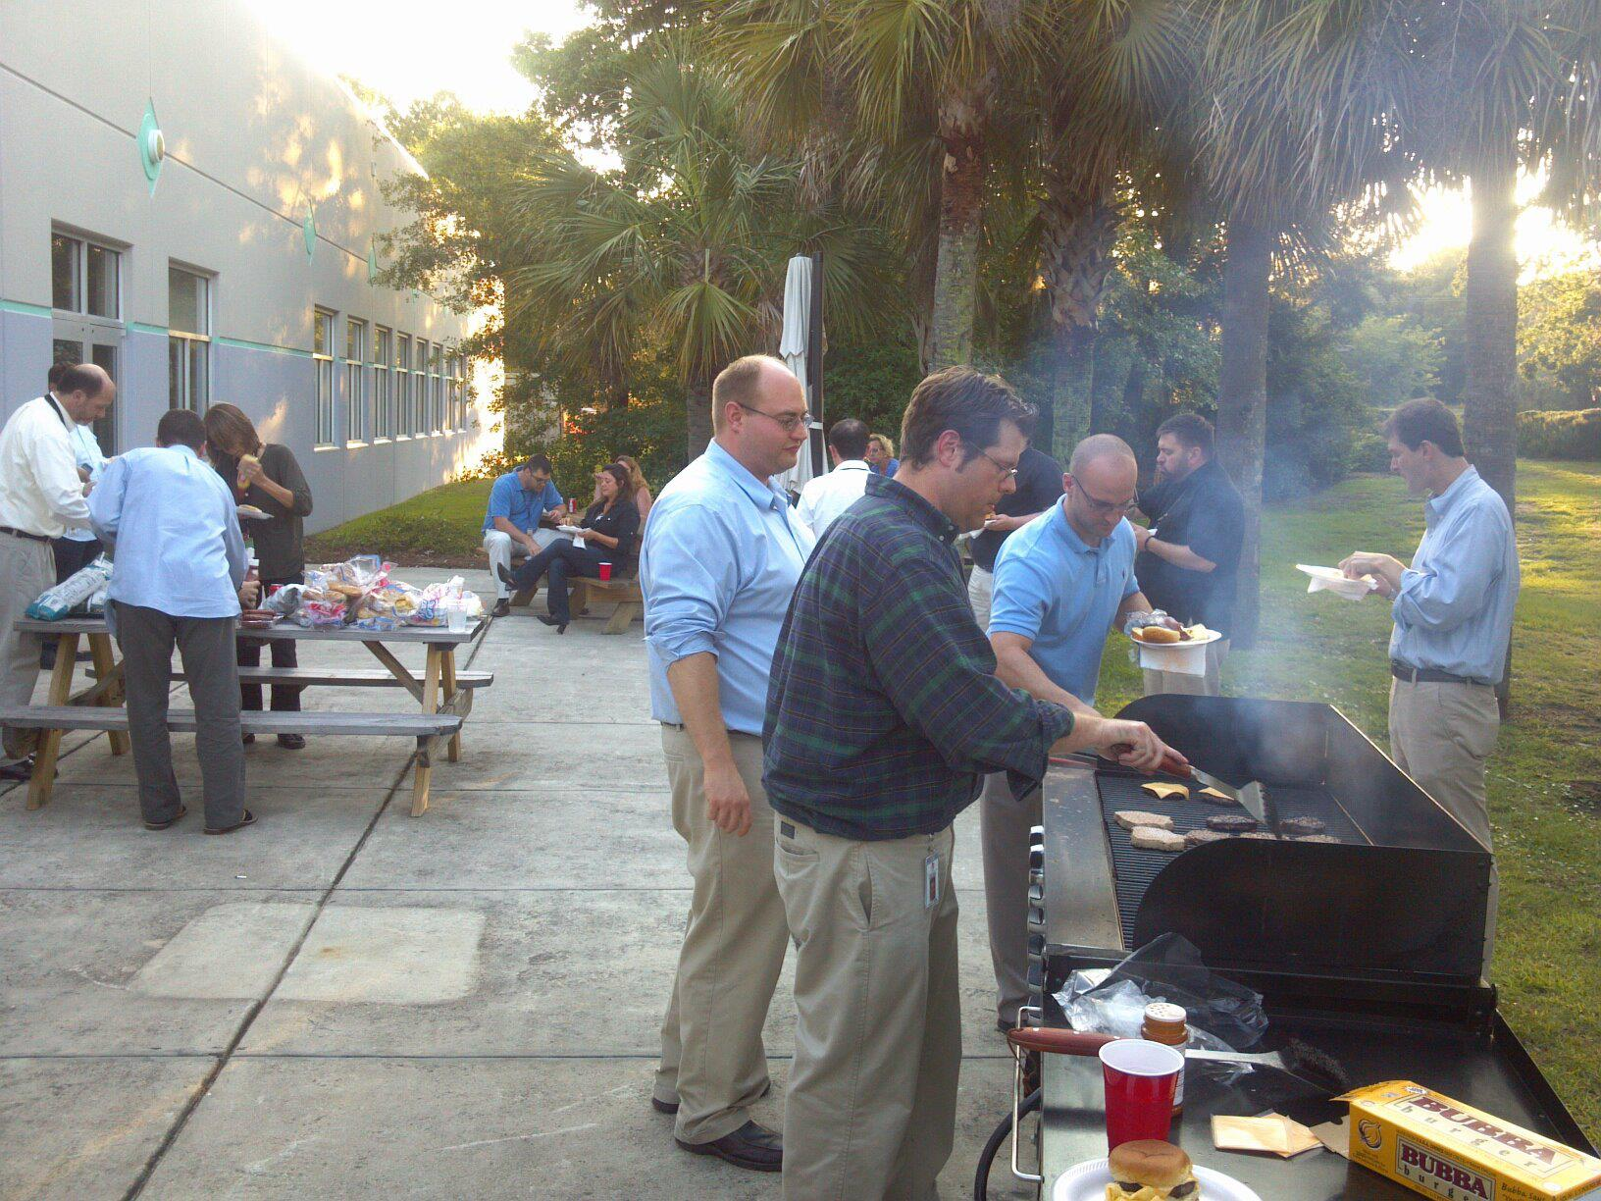
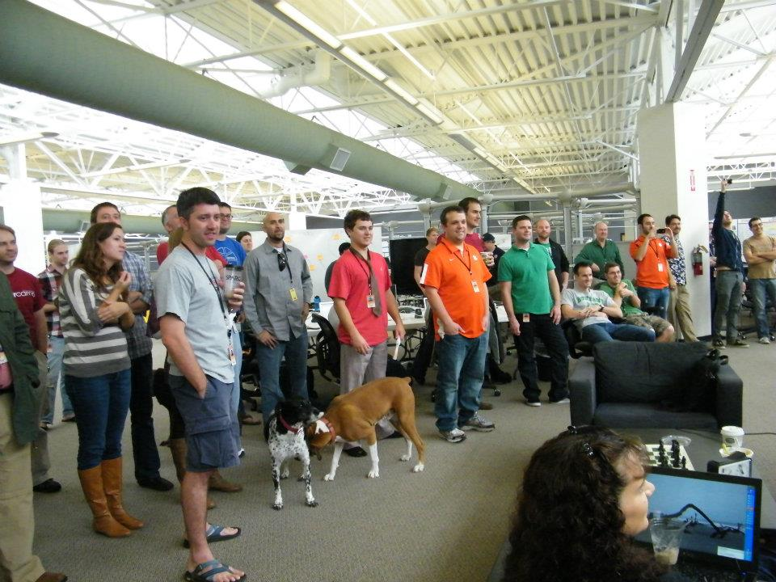
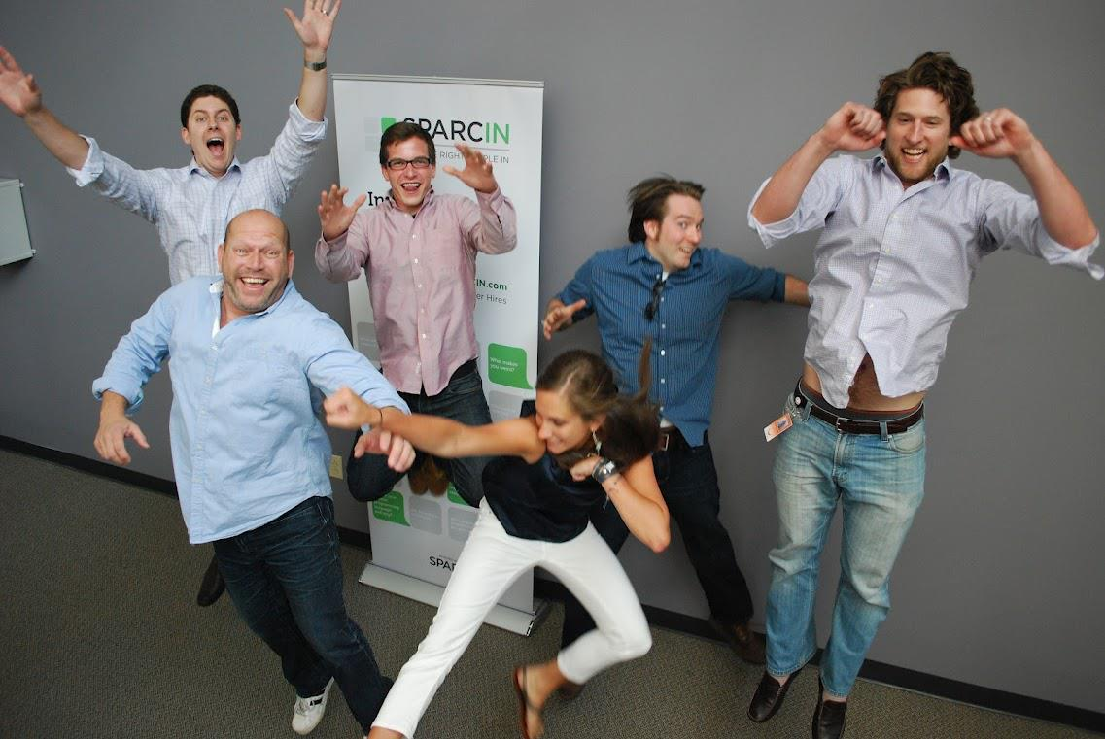
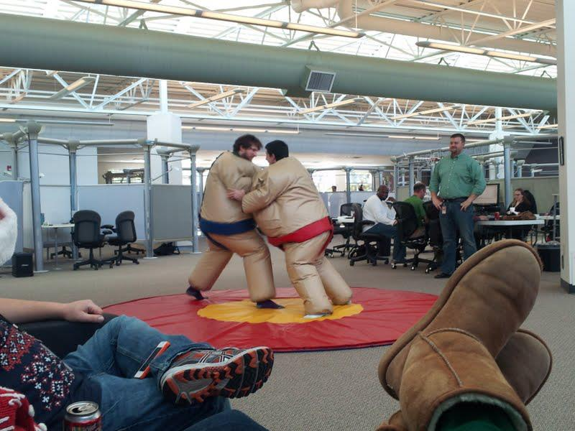
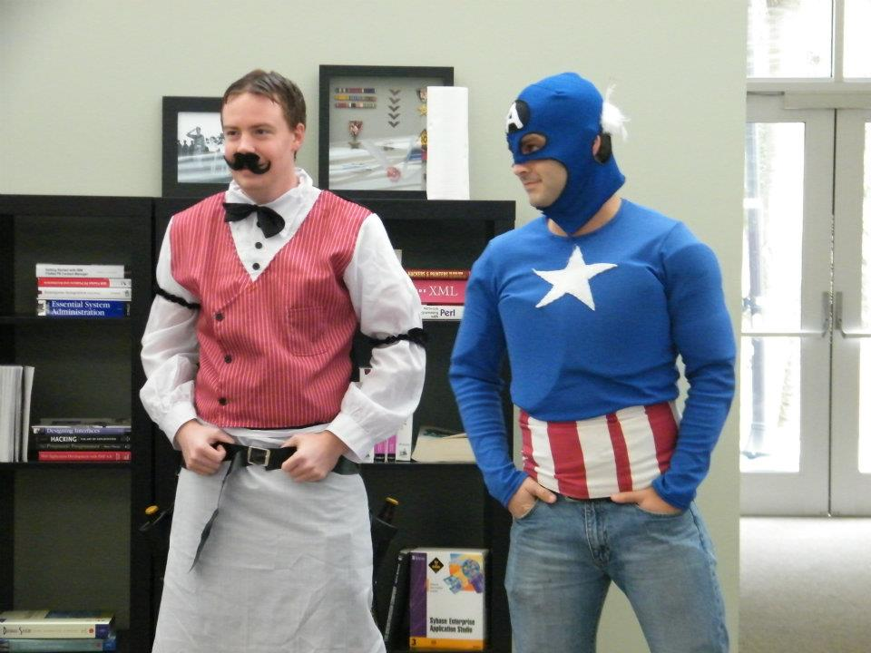
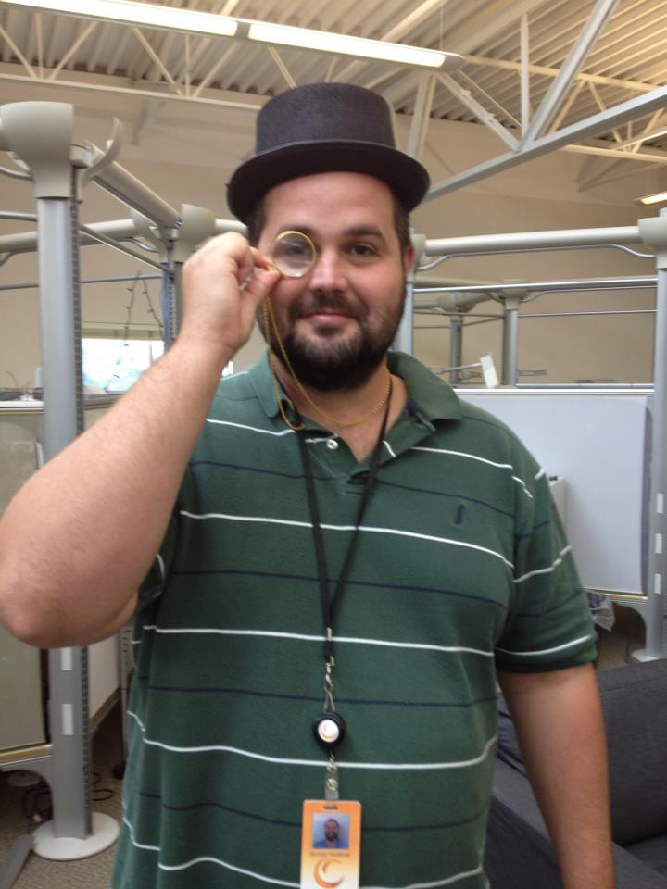
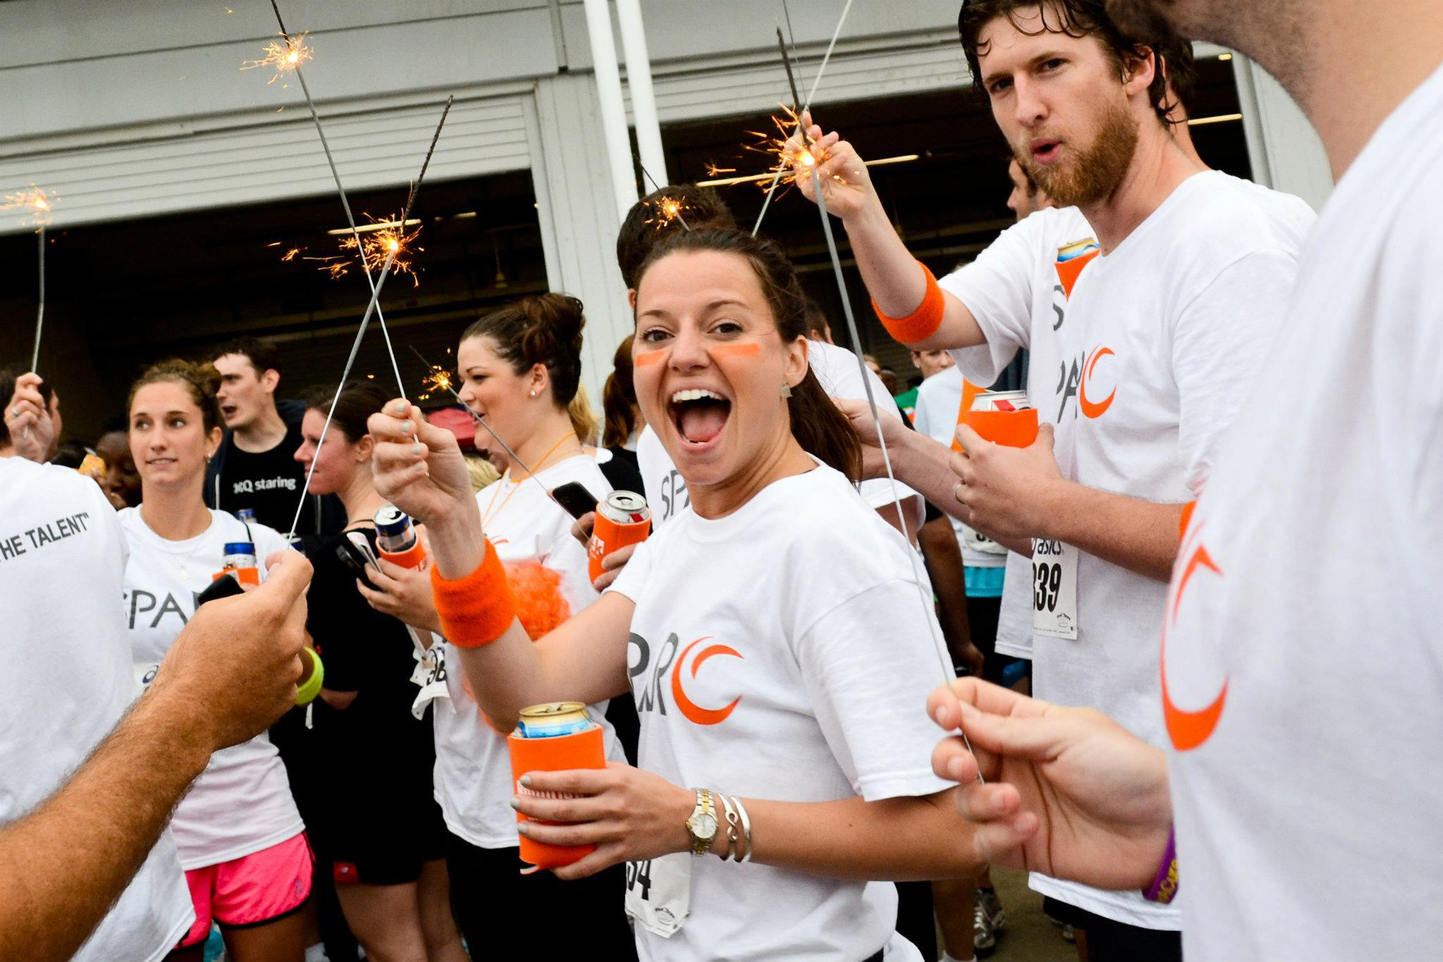
Tours
Notes:
We have transparency at every level here at SPARC that starts once you walk into the building
What you may see – dogs, nerf darts, cookouts, ping-pong, collaboration, whiteboard, backlogs, project progress, music, ppl on FB, meetings
Cop and his tour
So how is this open source?
We show you everything and
We solicit feedback

Slide 13
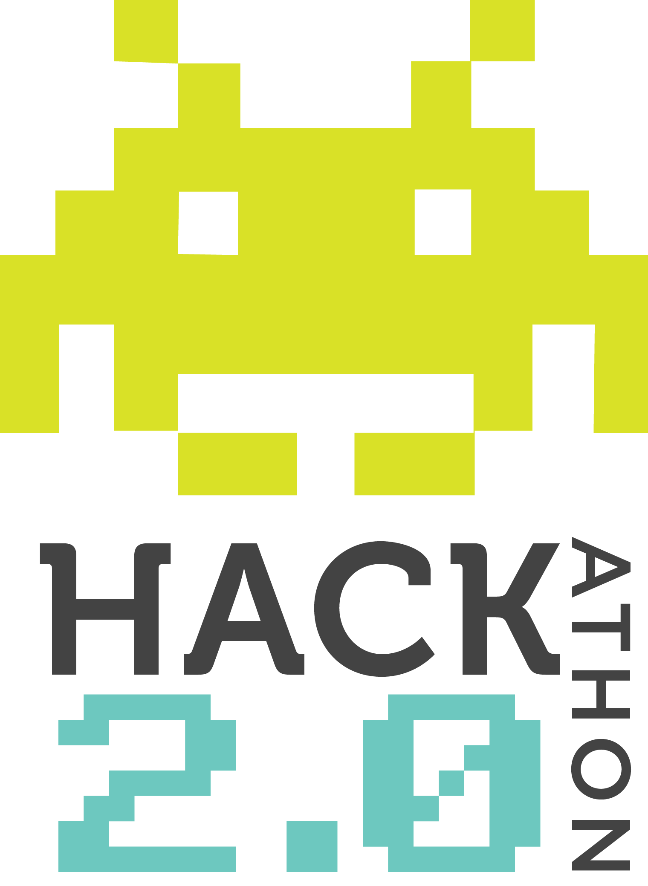
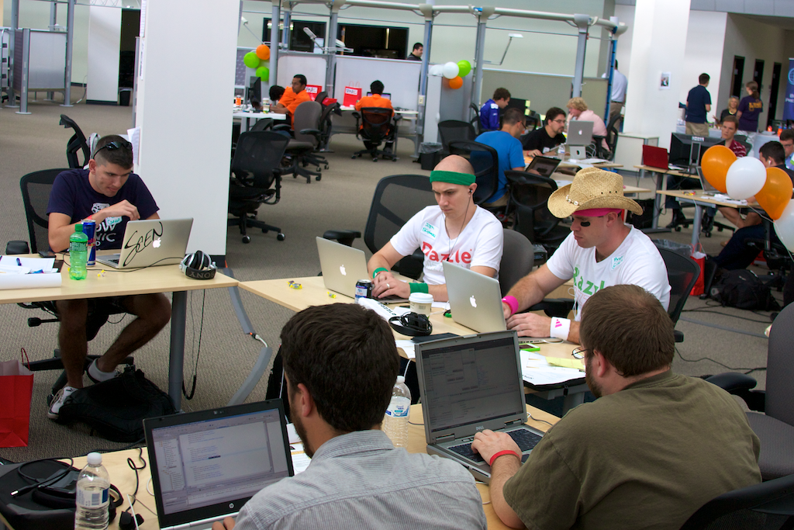
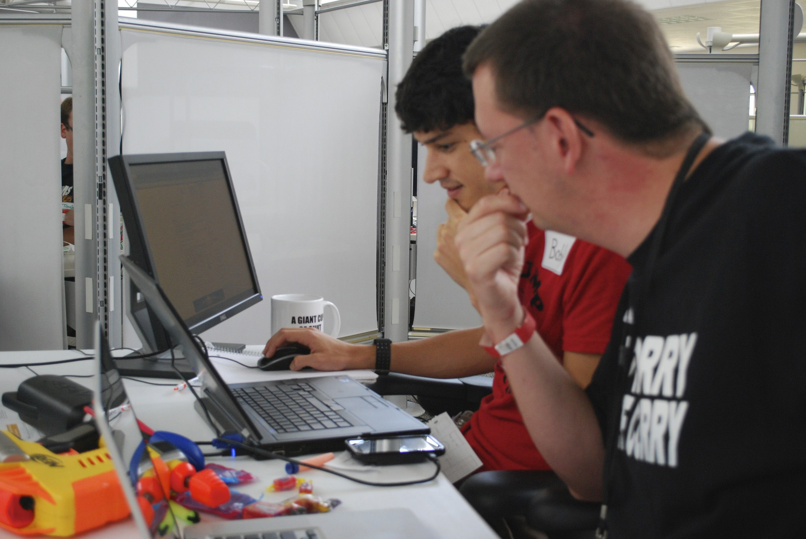
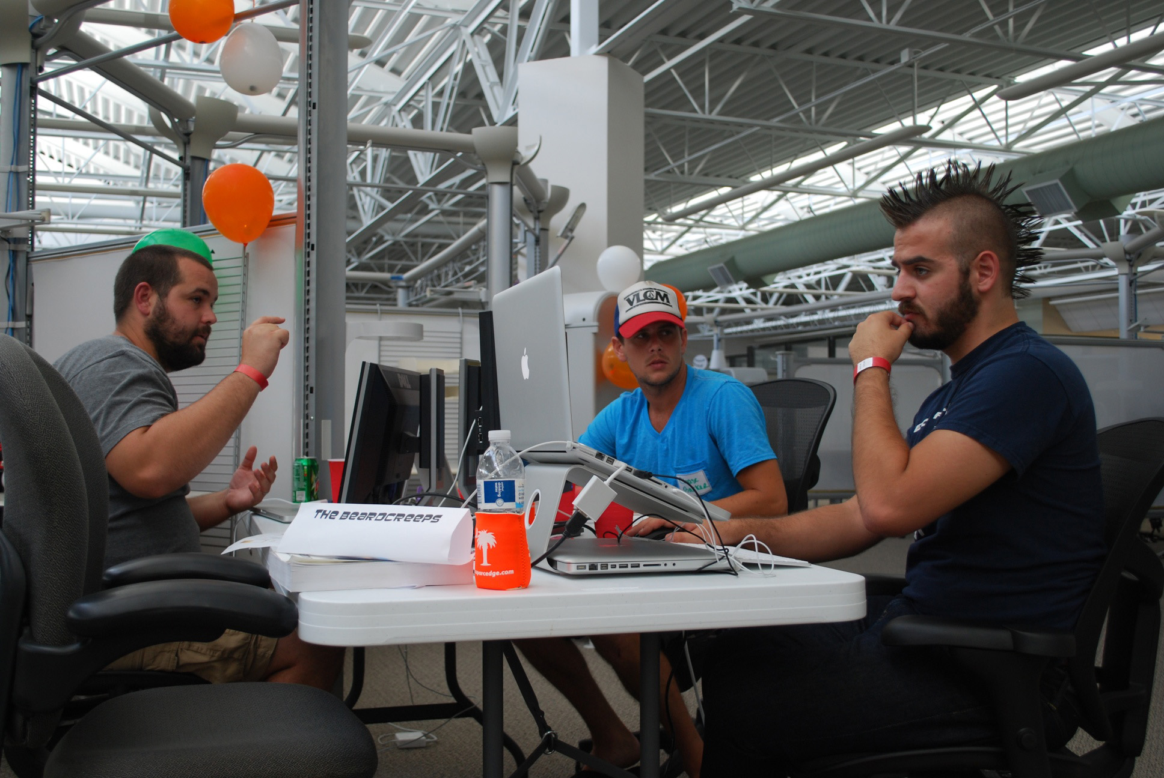
Hackathons
Notes:
Describe the event
Teams dressed up
Food & beverages
Caffeine and beer
Games
All ages
Tell how great the event was and what it was like
So how is this open source?
Open source the code back to the community
Volunteers to help us run it
Winnings donated back to charity

Slide 14
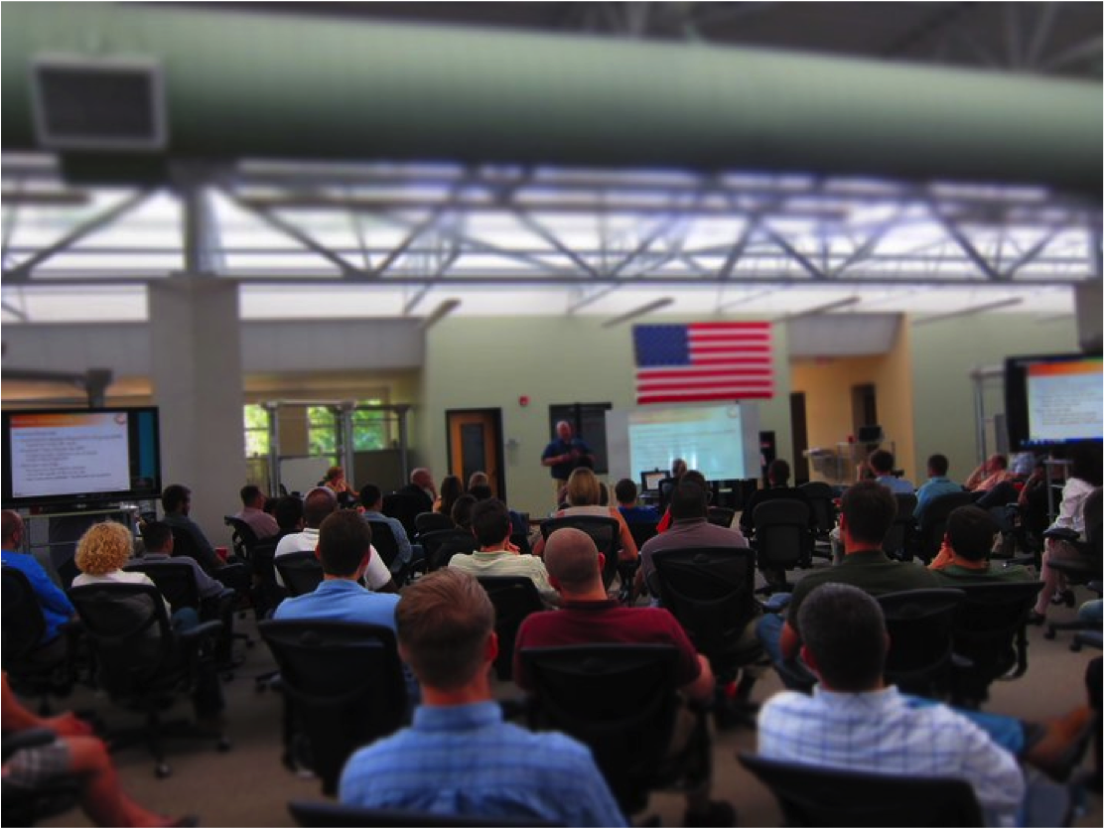
SPARC University
Notes:
Why do we have SPARC U
lunch-and-learns, Hosting user groups, multi-day long classes; android development for example, Certifications
We have even hosted GitHub, VMWare, Healthy Lifestyles, Employee Recognition the list goes on
Github and going for drinks afterward
InHouse open source software
So how is this open source?
open to the public
Team members generate content
Surveys and feedback on how to make it better

Slide 15

SPARC Ventures
Notes:
Who believes they have a good idea?
Anyone who has tried to start their own business knows it hard…it’s damn hard.
open source SPARC’s SDLC
Application stage and if it’s a good idea we move forward from alpha all the way to release to production
First round Q1 this year and by 6/1 SPARC will new product
One of the ventures is even being funded by someone outside of SPARC.
At the end the venture team gets to be mini CEOs basically.
From ownership to profits
Venture getting outside funding
So how is this open source?
SPARC open sources its entire SDLC
and the resources that go along with it

Slide 16

SPARC Software
Notes:
Explain IQ
Explain knappsack

Slide 17






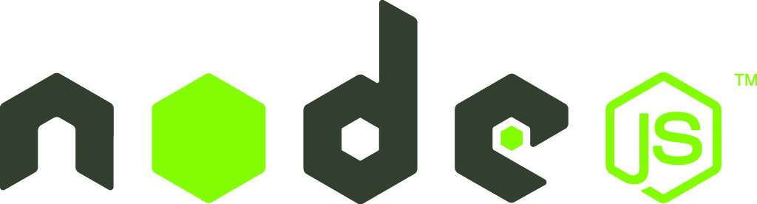




SPARC Uses OSS
Scala
and more…
connect
node-hashring
node-http-signature
Notes:
We use a lot of open source projects
A few not listed here

Slide 18

SPARC Contributes To OSS
connect
node-http-signature
node-hashring
Notes:
As in step 2 Contribute we give back to the community
Having contributed to the projects you see here

Slide 19
SPARC Releases OSS
We Open Source our Own Stuff Too!
knappsack
Secure, in-house mobile application distribution.
hook.io-ring
Hook.io hooks for creating ridiculously simple, self-forming consistent hashing rings.
cb
A minimal node.js utility for handling common (but often overlooked) callback scenarios.
jquery.jade.js
A lightweight jQuery plugin providing a friendly API for using the jade template engine.
connect-http-signature
Connect middleware wrapper for Joyent's HTTP Signature reference implementation.
and many more!
Notes:
We also have open sourced projects of our own
From messaging frameworks
To asynchronous callbacks routines
To even jQuery plugins
We open sourcing an entire product with knappsack

Slide 20
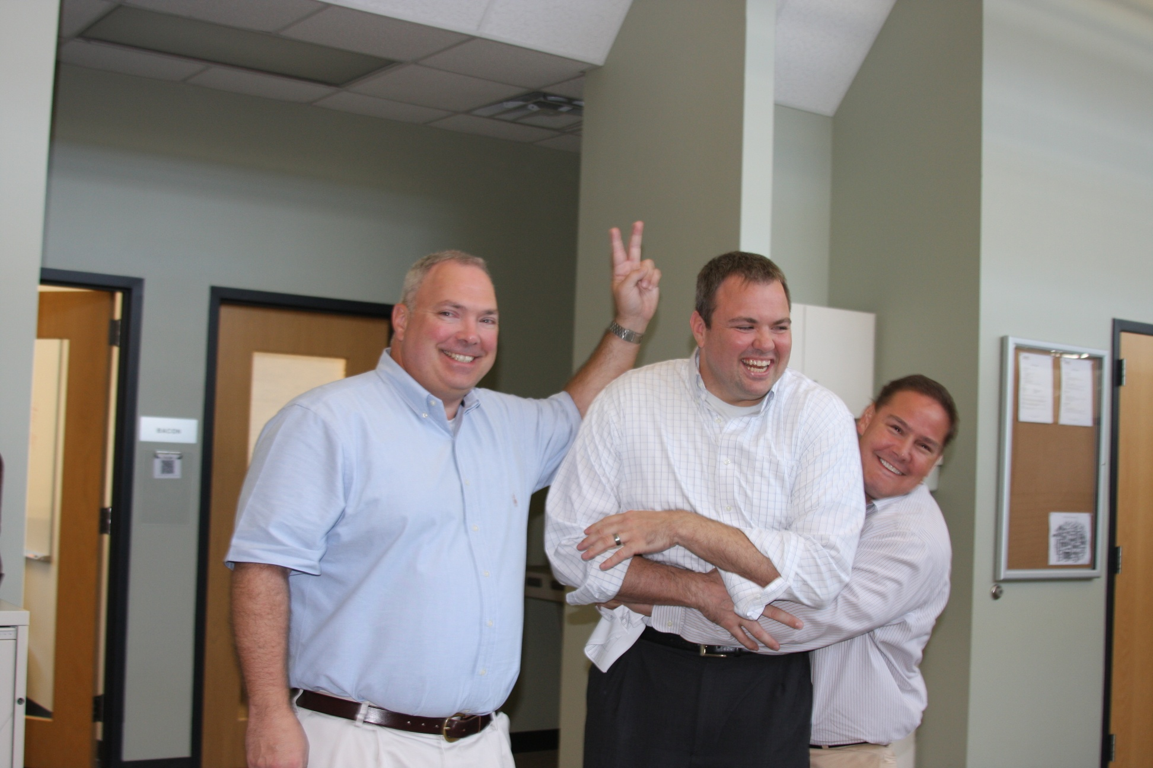


Human Resources
Notes:
We basically just give this stuff away ☺ we’ve given all the below away
Check-in Process is shared and feedback is gather
Team Members have the ability to contribute
Normal beer for example
Better chairs
Annual Review Process
Team Members have actually helped shape it
Other companies have made it better
Goal Setting
Many companies feed from the executive level down
We have the team members define goals for the company
Shared with other companies and contributed to by other companies
How is this open source?
All of our company contributes to our HR processes
All of our HR processes are shared and contributed to by others
Only making them stronger

Slide 21
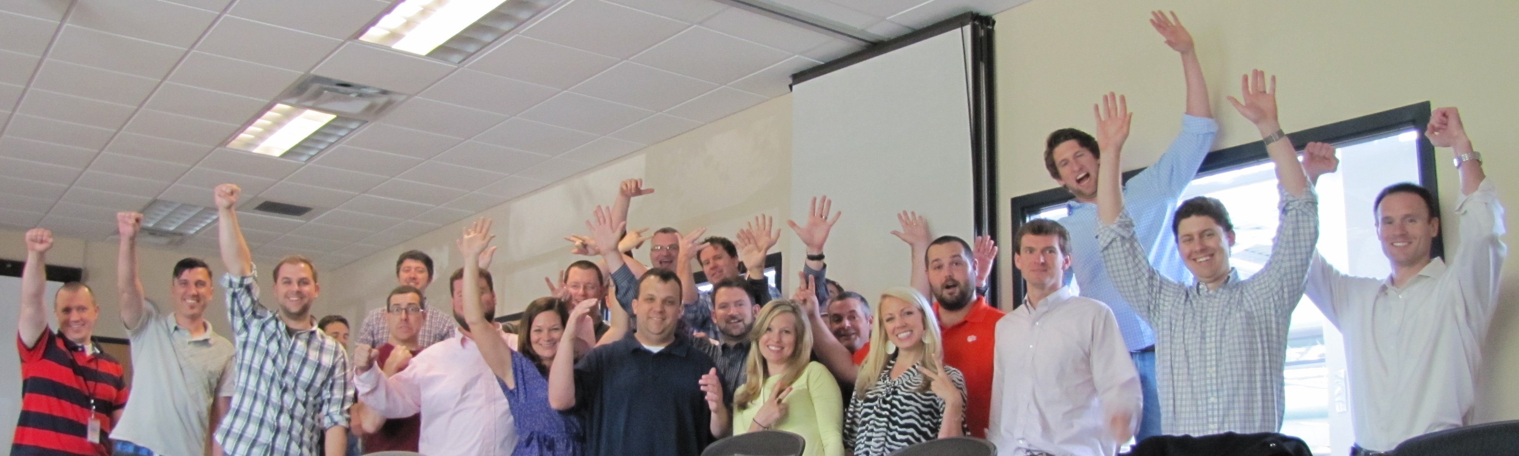
Recruiting
Notes:
Interview process
Anyone can sit in on an interview – engineer to CEO
see all the comments and feedback
shadow day – bait & switch
single veto policy
jobs for family and friends
Even candidates where there isn’t a fit
Story about asking candidates how tour went and what we could do to make the interview better
So how is this open source?
Everyone contributes
We always ask candidates how the interview went and for feedback

Slide 22
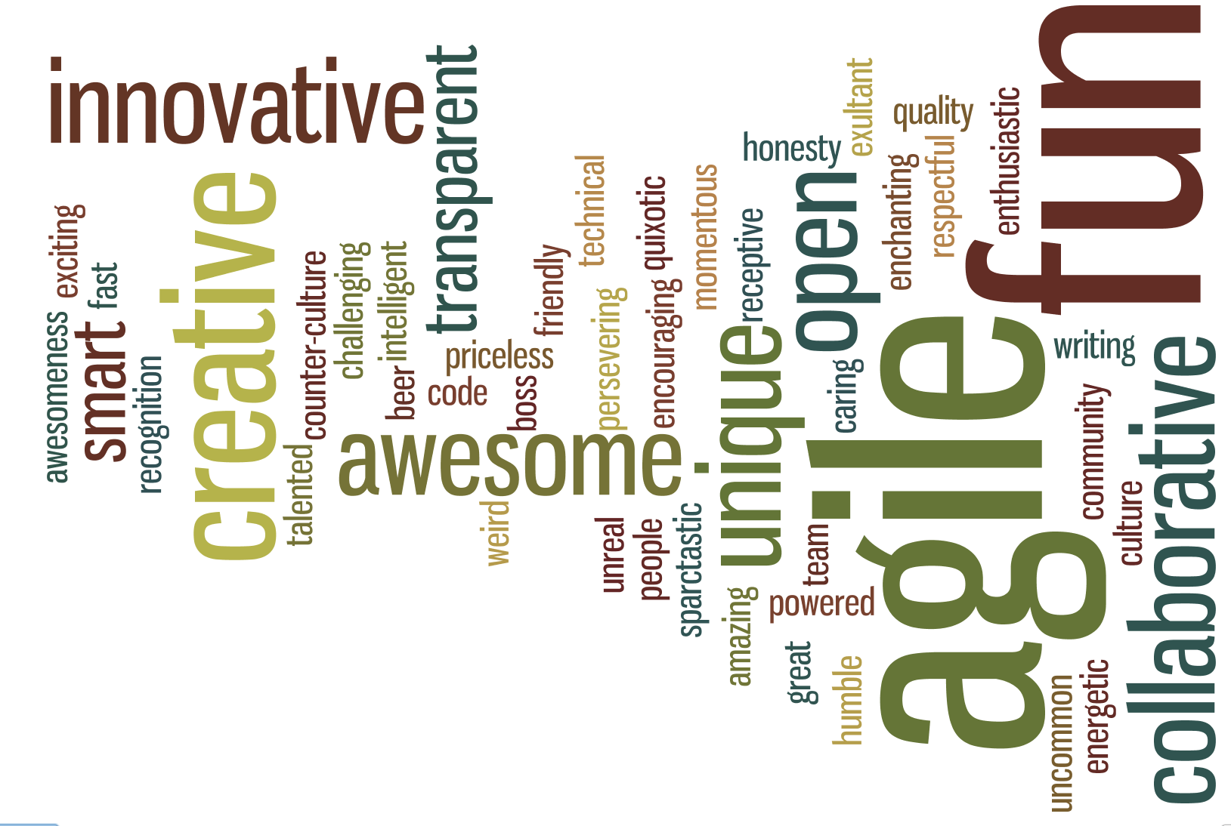
Culture
Notes:
A transparent, open culture always asking how we could have done better
A culture where whether your are a 1st day intern or the 1st employee hired you feel and know that you do not need permission to contribute.
It creates a motivational vs competitive environment
Allows up to be a Stage 4&5 company
Project Updates
SPARC Spontaneous
Sparc showcase
Project Brainstorming
Clients in the building and people
Table Time
So how is this open source?
Always looking to share what we have…always looking for others to contribute

Slide 23
Your Challenge!
Why Don’t We
Open Source
Everything?
Notes:
So I challenged you early on to open source everything you can
Gave you the promise of
an engaged, excited and more innovative workforce
understanding your business better
competitors becoming your collaborators
Gave you 5 easy steps to get there
Gave you some insight into why we at SPARC open source
And even gave you some concrete examples of things SPARC open sources
And so I’ll reiterate my challenge
And ask you to ask yourself, why don’t we open source our entire company?

Slide 24
Oh, and by the way…
This Entire Presentation Has Been Open Sourced!
https://github.com/sparcedge/
Notes:
Oh and btw…as I have said SPARC, is embraces the open source model
and in that spirit we have open sourced this entire presentation which you can find at the above link
It’s free to you to take and use as needed and improve as you want
I only ask that if you do please drop me a line and let me know…I’d love to hear from you

Slide 25
Thank You!
bob.williams@sparcedge.com
@_bobwilliams
tours@sparcedge.com
www.sparcedge.com
Notes:
Ok, I’ve taken up enough of your time and want to thank you for being a part of this
If you have questions I’ll be around, please come find me and we can chat
Thank you!

